Slide 1
Copyright Notice
These slides are distributed under the Creative Commons License.
DeepLearning.AI makes these slides available for educational purposes. You may not use or distribute these slides for commercial purposes. You may make copies of these slides and use or distribute them for educational purposes as long as you cite DeepLearning.AI as the source of the slides.
For the rest of the details of the license, see https://creativecommons.org/licenses/by-sa/2.0/legalcode

Slide 2
Model Serving Architecture
Model Serving: Patterns and Infrastructure

Slide 3

ML Infrastructure
Train and deploy on your own hardware infrastructure
Manually procure hardware GPUs, CPUs etc
Proﬁtable for large companies running ML projects for longer time
On Prem
On Cloud
Train and deploy on cloud choosing from several service providers
Amazon Web Services, Google Cloud Platform, Microsoft Azure, etc

Slide 4
ML Infrastructure
Train and deploy on your own hardware infrastructure
Manually procure hardware GPUs, CPUs etc
Proﬁtable for large companies running ML projects for longer time
On Prem
On Cloud
Train and deploy on cloud choosing from several service providers
Amazon Web Services, Google Cloud Platform, Microsoft Azure, etc

Slide 5
ML Infrastructure
Train and deploy on your own hardware infrastructure
Manually procure hardware GPUs, CPUs etc
Proﬁtable for large companies running ML projects for longer time
On Prem
On Cloud
Train and deploy on cloud choosing from several service providers
Amazon Web Services, Google Cloud Platform, Microsoft Azure, etc

Slide 6
Model Serving
On Prem
Can use open source, pre-built servers
TF-Serving, KF-Serving, NVidia and more...
On Cloud
Create VMs and use open source pre-built servers
Use the provided ML workﬂow

Slide 7
Model Serving
On Prem
Can use open source, pre-built servers
TF-Serving, KF-Serving, NVidia and more...
On Cloud
Create VMs and use open source pre-built servers
Use the provided ML workﬂow

Slide 8
Model Serving
On Prem
Can use open source, pre-built servers
TF-Serving, KF-Serving, NVidia and more...
On Cloud
Create VMs and use open source pre-built servers
Use the provided ML workﬂow

Slide 9

Model Servers
Simplify the task of deploying machine learning models at scale.
Can handle scaling, performance, some model lifecycle management etc.,
What’s in this image?
Model File
Model Server
REST / gRPC
Dog 0.99

Slide 10
Model Servers
Simplify the task of deploying machine learning models at scale.
Can handle scaling, performance, some model lifecycle management etc.,
What’s in this image?
Model File
Model Server
REST / gRPC
Dog 0.99

Slide 11
Model Servers
Simplify the task of deploying machine learning models at scale.
Can handle scaling, performance, some model lifecycle management etc.,
What’s in this image?
Model File
Model Server
REST / gRPC
Dog 0.99

Slide 12
Model Servers
Simplify the task of deploying machine learning models at scale.
Can handle scaling, performance, some model lifecycle management etc.,
What’s in this image?
REST / gRPC
Dog 0.99
Model File
Model Server

Slide 13




Model Servers
TensorFlow Serving
TorchServe
KF Serving

Slide 14
TensorFlow Serving
Supports many servables
Feature Transformations
TF Models
Non TF Models
Word Embeddings
Vocabularies
Out of the box integration with TensorFlow Models
Batch and Real-time Multi-Model Serving Inference
Exposes gRPC and REST endpoints

Slide 15
TensorFlow Serving
Supports many servables
Feature Transformations
TF Models
Non TF Models
Word Embeddings
Vocabularies
Out of the box integration with TensorFlow Models
Batch and Real-time Inference
Multi-Model Serving
Exposes gRPC and REST endpoints

Slide 16
TensorFlow Serving
Supports many servables
Feature Transformations
TF Models
Non TF Models
Word Embeddings
Vocabularies
Out of the box integration with TensorFlow Models
Multi-Model Serving
Batch and Real-time Inference
Exposes gRPC and REST endpoints

Slide 17
TensorFlow Serving
Supports many servables
Feature Transformations
TF Models
Non TF Models
Word Embeddings
Vocabularies
Out of the box integration with TensorFlow Models
Exposes gRPC and REST endpoints
Batch and Real-time Multi-Model Serving Inference

Slide 18
TensorFlow Serving Architecture
CORE
DynamicManager
ASPIRED
TF
Servable
CLIENT
ServableHandle
Loader
VERSIONS
VersionPolicy
Legend:
Source
FILE SYSTEM
Blue: Caller-speciﬁc code
Green: TF Serving core classes / APIs Yellow: Pluggable implementations

Slide 19
TensorFlow Serving Architecture
CORE
TF
Servable
DynamicManager
ASPIRED
CLIENT
ServableHandle
Loader
VERSIONS
VersionPolicy
Legend:
Source
FILE SYSTEM
Blue: Caller-speciﬁc code
Green: TF Serving core classes / APIs Yellow: Pluggable implementations

Slide 20
TensorFlow Serving Architecture
CORE
DynamicManager
ASPIRED
TF
Servable
CLIENT
ServableHandle
Loader
VERSIONS
VersionPolicy
Legend:
Source
FILE SYSTEM
Blue: Caller-speciﬁc code
Green: TF Serving core classes / APIs Yellow: Pluggable implementations

Slide 21
TensorFlow Serving Architecture
CORE
ASPIRED VERSIONS
CLIENT
ServableHandle
DynamicManager
Loader
TF
Servable
VersionPolicy
Legend:
Source
FILE SYSTEM
Blue: Caller-speciﬁc code
Green: TF Serving core classes / APIs Yellow: Pluggable implementations

Slide 22
TensorFlow Serving Architecture
CORE
DynamicManager
VersionPolicy
ASPIRED
TF
Servable
CLIENT
ServableHandle
Loader
VERSIONS
Legend:
Source
FILE SYSTEM
Blue: Caller-speciﬁc code
Green: TF Serving core classes / APIs Yellow: Pluggable implementations

Slide 23
TensorFlow Serving Architecture
CORE
CLIENT ServableHandle
DynamicManager
ASPIRED
TF
Servable
Loader
VERSIONS
VersionPolicy
Legend:
Source
FILE SYSTEM
Blue: Caller-speciﬁc code
Green: TF Serving core classes / APIs Yellow: Pluggable implementations

Slide 24
TensorFlow Serving Architecture
CORE
DynamicManager
ASPIRED
TF
Servable
CLIENT
ServableHandle
Loader
VERSIONS
VersionPolicy
Legend:
Source
FILE SYSTEM
Blue: Caller-speciﬁc code
Green: TF Serving core classes / APIs Yellow: Pluggable implementations

Slide 25
TensorFlow Serving Architecture
CORE
DynamicManager
ASPIRED
TF
Servable
CLIENT
ServableHandle
Loader
VERSIONS
VersionPolicy
Legend:
Source
FILE SYSTEM
Blue: Caller-speciﬁc code
Green: TF Serving core classes / APIs Yellow: Pluggable implementations

Slide 26
TensorFlow Serving Architecture
CORE
ASPIRED VERSIONS
CLIENT
ServableHandle
DynamicManager
Loader
TF
Servable
VersionPolicy
Legend:
Source
FILE SYSTEM
Blue: Caller-speciﬁc code
Green: TF Serving core classes / APIs Yellow: Pluggable implementations

Slide 27
TensorFlow Serving Architecture
CORE
DynamicManager
ASPIRED
TF
Servable
CLIENT
ServableHandle
Loader
VERSIONS
VersionPolicy
Legend:
Source
FILE SYSTEM
Blue: Caller-speciﬁc code
Green: TF Serving core classes / APIs Yellow: Pluggable implementations

Slide 28
TensorFlow Serving Architecture
CORE
ASPIRED VERSIONS
CLIENT
ServableHandle
DynamicManager
Loader
TF
Servable
VersionPolicy
Legend:
Source
FILE SYSTEM
Blue: Caller-speciﬁc code
Green: TF Serving core classes / APIs Yellow: Pluggable implementations

Slide 29
TensorFlow Serving Architecture
CORE
ASPIRED VERSIONS
CLIENT
ServableHandle
DynamicManager
Loader
TF
Servable
VersionPolicy
Legend:
Source
FILE SYSTEM
Blue: Caller-speciﬁc code
Green: TF Serving core classes / APIs Yellow: Pluggable implementations

Slide 30
NVIDIA Triton Inference Server
Simpliﬁes deployment of AI models at scale in production.
Open source inference serving software
Deploy trained models from any framework:
TensorFlow, TensorRT, PyTorch, ONNX Runtime, or a custom framework
Models can be stored on:
Local storage, AWS S3, GCP, Any CPU-GPU Architecture (cloud, data centre or edge)
HTTP REST or gRPC endpoints are supported.

Slide 31






Architecture
Client Application
Python/C++ Client Library
HTTP
gRPC
Model Repository
Triton Inference Server Architecture supports:
Single GPU for multiple models from same or different frameworks
Multi-GPU for same model
Can run instances of model on multiple GPUs for increased inference performance.
Supports model ensembles.
Client app can directly link to C API
Model Management
C API
Inference Request
Inference Response
Pre model
scheduler queues
Framework Backends
Scheduler
Custom
Status health report export
HTTP
GPU GPU GPU GPU CPU

Slide 32



Designed for Scalability
Data Center | Cloud | Edge
AI Inference Cluster
CPU | GPU
Front End Client Applications
Load balancer (optional)
Triton Inference Server
Triton Inference Server
Front End Client Applications
Triton Inference Server
Triton Inference Server
AI Model Repository
Can integrate with KubeFlow pipelines for end to end AI workﬂow

Slide 33
Torch Serve
Model serving framework for PyTorch models.
Initiative from AWS and Facebook
TorchServe
Default handlers for Image Classiﬁcation, Object Detection, Image Segmentation, Text Classiﬁcation
Batch and Real-time Inference
Supports REST Endpoints
Multi-Model Serving
Monitor Detail Logs and Customized Metrics
A/B Testing

Slide 34
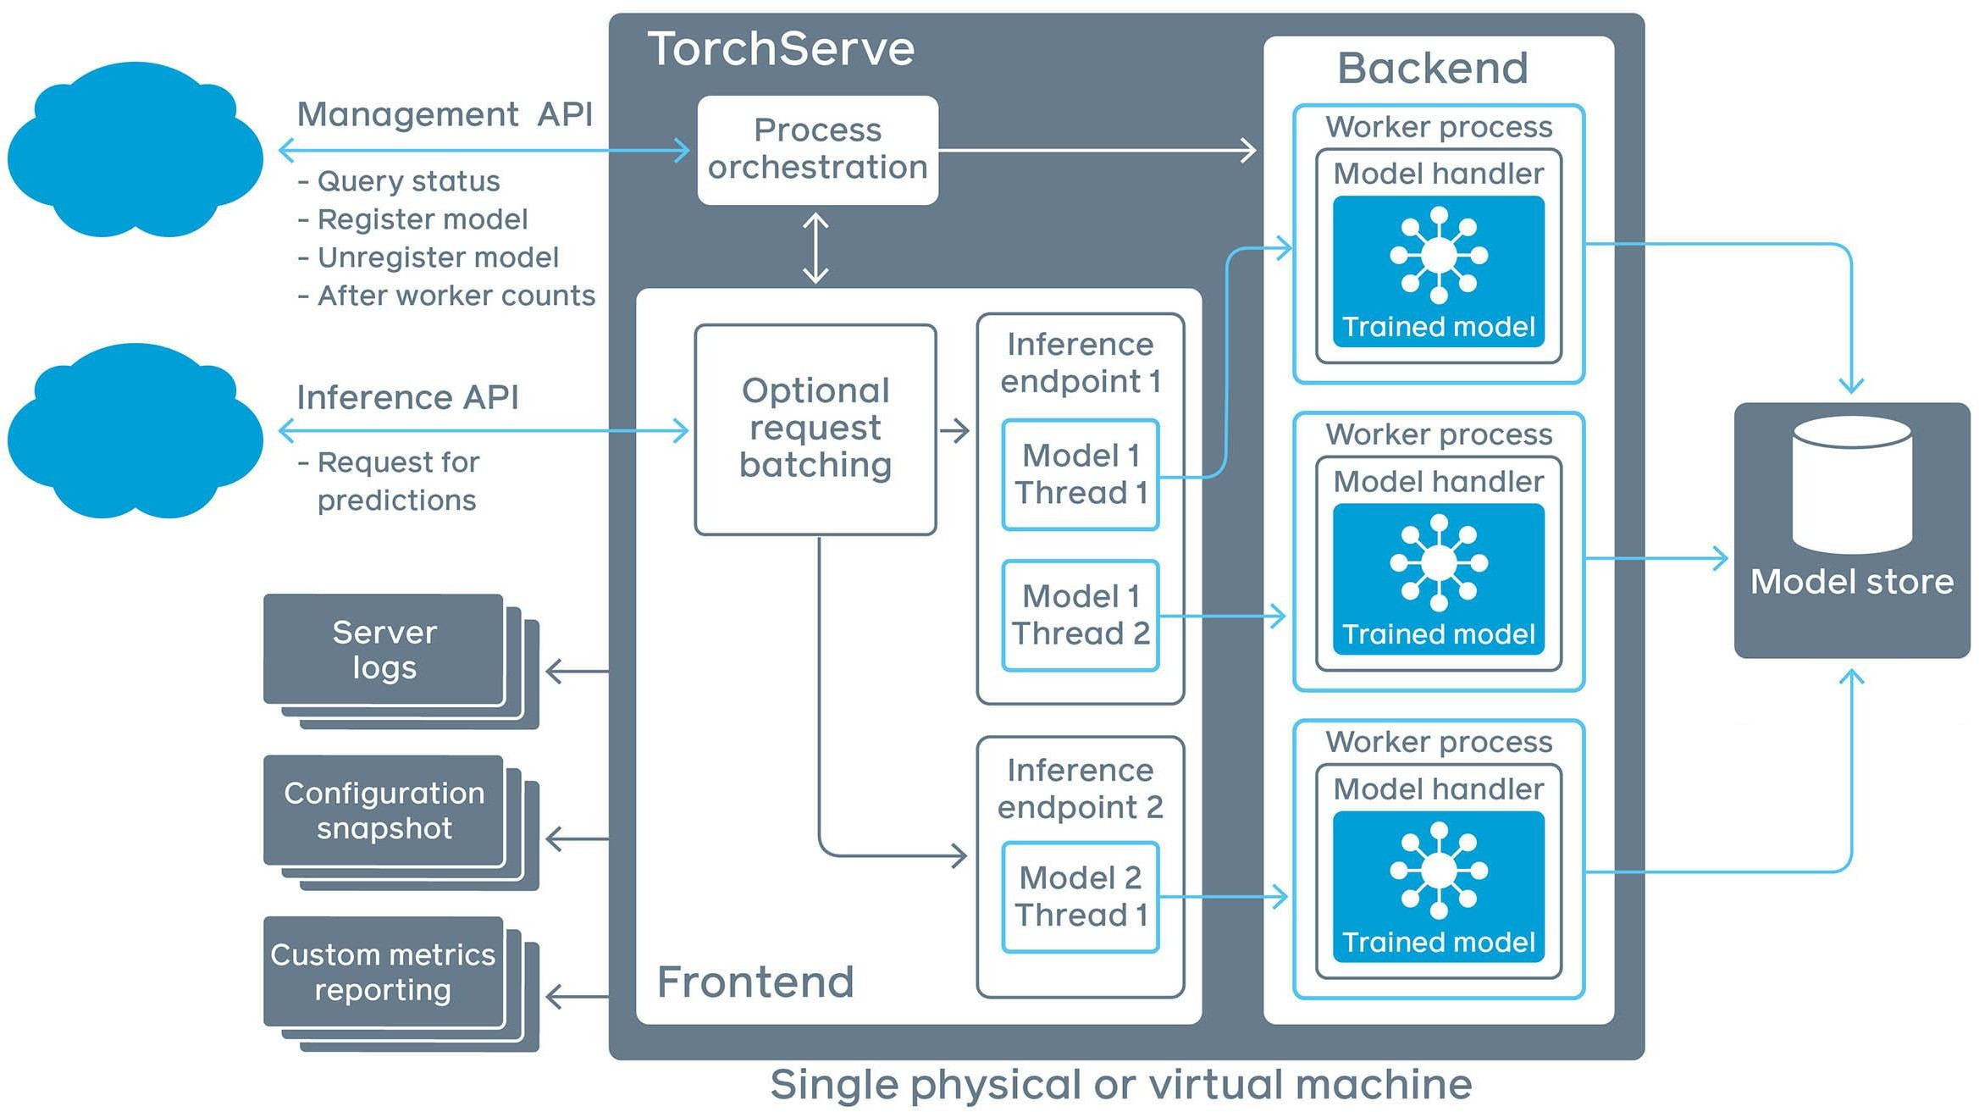
TorchServe Architecture

Slide 35
TorchServe Architecture

Slide 36
TorchServe Architecture

Slide 37
TorchServe Architecture

Slide 38
TorchServe Architecture

Slide 39






KFServing
KF Serving
Enables serverless inferencing on Kubernetes.
Provides high abstraction interfaces for common ML frameworks like TensorFlow, PyTorch, scikit-learn etc.
pre-process
predict
post-process
explain
KFServing
Knative
Istio
Kubernetes
Compute Cluster, CPU GPU, TPU

Slide 40
Scaling Infrastructure
Model Serving: Patterns and Infrastructure

Slide 41
Why is Scaling Important?

Slide 42

Why is Scaling Important?

Slide 43
Why is Scaling Important?

Slide 44

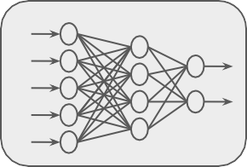
Why is Scaling Important?
Server

Slide 46
+ Increased Power
+ Upgrading
+ More RAM
+ Faster Storage
+ Adding or upgrading GPU/TPU

Slide 47


Slide 48
+ More CPUs/GPUs instead of bigger ones
+ Scale up as needed
+ Scale back down to minimums

Slide 49
Why Horizontal Over Vertical Scaling
Shrink or grow no of nodes based on load, throughput, latency requirements.
No need for taking existing servers ofﬂine for scaling
Beneﬁt of elasticity
Application never goes ofﬂine
Add more nodes any time at increased cost
No limit on hardware capacity

Slide 50
Why Horizontal Over Vertical Scaling
Shrink or grow no of nodes based on load, throughput, latency requirements.
No need for taking existing servers ofﬂine for scaling
Beneﬁt of elasticity
Application never goes ofﬂine
Add more nodes any time at increased cost
No limit on hardware capacity

Slide 51
Why Horizontal Over Vertical Scaling
Shrink or grow no of nodes based on load, throughput, latency requirements.
No need for taking existing servers ofﬂine for scaling
Beneﬁt of elasticity
Application never goes ofﬂine
Add more nodes any time at increased cost
No limit on hardware capacity

Slide 52
Why Horizontal Over Vertical Scaling
Shrink or grow no of nodes based on load, throughput, latency requirements.
No need for taking existing servers ofﬂine for scaling
Beneﬁt of elasticity
Application never goes ofﬂine
Add more nodes any time at increased cost
No limit on hardware capacity

Slide 53
Typical System Architecture
App
App
App
Bin/ Library
Operating System
Hardware

Slide 54
Virtual Machine (VM) Architecture
Virtual Machine
Virtual Machine
App
App
App
App
App
App
Bin/ Library
Bin/ Library
Operating System
Operating System
App
App
App
Bin/ Library
Hypervisor
Operating System
Operating System
Hardware
Hardware

Slide 55
VM Management
Virtual Machine
Virtual Machine
App
App
App
App
App
App
Bin/ Library
Bin/ Library
Operating System
Operating System
App
App
App
Bin/ Library
Hypervisor
Operating System
Operating System
Hardware
Hardware

Slide 56
Hypervisor and Scaling
Virtual Machine
Virtual Machine
App
App
App
App
App
App
Bin/ Library
Bin/ Library
Operating System
Operating System
App
App
App
Bin/ Library
Hypervisor
Operating System
Operating System
Hardware
Hardware

Slide 57
VM Limitations
 | App | App | App | App | App | App
 | Bin/ Library Operating System |  |  | Bin/ Library Operating System
 | Virtual Machine |  |  | Virtual Machine
App
App
App
Bin/ Library
Hypervisor
Operating System
Operating System
Hardware
Hardware

Slide 58
Building Containers
App
App
App
App
Container
Container
Container
App
App
App
App
App
Bin/ Library
Bin/ Library
Operating System
Operating System
Bin/Library
Bin/Library
Bin/Library
Virtual Machine Virtual Machine
Hypervisor
Container Runtime
Operating System
Operating System
Hardware
Hardware

Slide 59
Containers Advantages
Container Container Container
App
App
App
App
App
App
App
App
App
Bin/ Library
Bin/ Library
Operating System
Operating System
Bin/Library
Bin/Library
Bin/Library
Virtual Machine Virtual Machine
Hypervisor
Container Runtime
Operating System
Operating System
Hardware
Hardware

Slide 60
Containers Advantages
Container
Container
Container
Less OS requirements - more apps!
Abstraction
Easy deployment based on container runtime
App
App
App
Bin/Library
Bin/Library
Bin/Library
Container Runtime
Operating System
Hardware

Slide 61
Docker: Container Runtime
Container
Container
Container
App
App
App
Open source container technology
Most popular container runtime
Started as container technology for Linux
Available for Windows applications as well.
Can be used in data centres, personal machines or public cloud.
Docker partners with major cloud services for containerization.
Bin/Library
Bin/Library
Bin/Library
Docker
Operating System
Hardware

Slide 62
Enter Container Orchestration
Apps & Services
Manages life cycle of containers in production environments
Manages scaling of containers
Ensures reliability of containers
Distributes resources between containers.
Monitors health of containers
Orchestration
Service Management
Scheduling
Resource Management
Container Runtime
Container Runtime
Container Runtime
Machine & OS
Machine & OS
Machine & OS
Machine Infrastructure

Slide 63
Enter Container Orchestration
 | Apps & Services
Service Management Scheduling Resource Management
 | Container Runtime |  | Container Runtime |  | Container Runtime
Manages life cycle of containers in production environments
Manages scaling of containers
Ensures reliability of containers
Distributes resources between containers.
Monitors health of containers
Orchestration
Machine & OS
Machine & OS
Machine & OS
Machine Infrastructure

Slide 64
Popular Container Orchestration Tools
Kubernetes
Docker Swarm

Slide 65
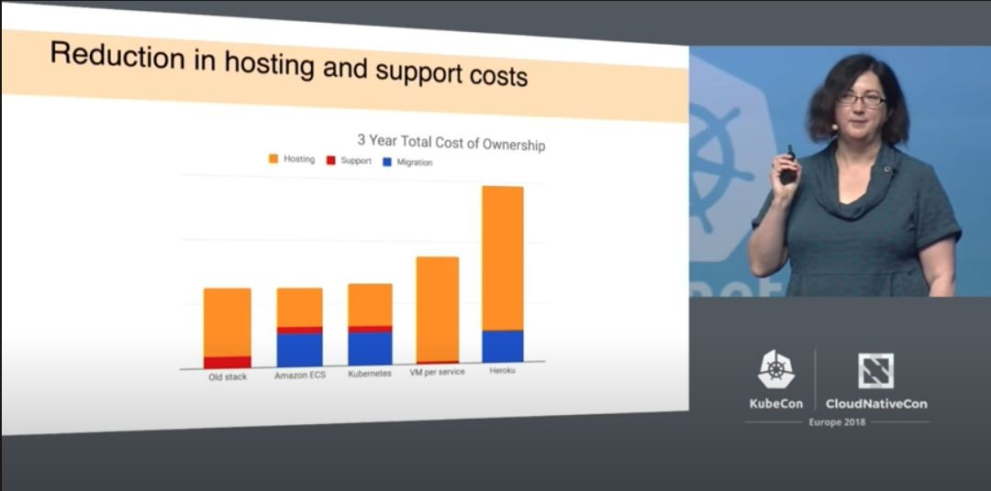
Kubernetes

Slide 66
ML Workﬂows on Kubernetes - KubeFlow
Dedicated to making deployments of machine learning (ML) workﬂows on Kubernetes simple, portable and scalable.
Anywhere you are running Kubernetes, you should be able to run Kubeﬂow.
Can be run on premise or on Kubernetes engine on cloud offerings AWS, GCP, Azure etc.,

Slide 67
Online Inference
Model Serving: Patterns and Infrastructure

Slide 68
Online Inference
Process of generating machine learning predictions in real time upon request.
Predictions are generated on a single observation of data at runtime.
Can be generated at any time of the day on demand
Observation
REST API
Model
Prediction

Slide 69
Online Inference
Process of generating machine learning predictions in real time upon request.
Predictions are generated on a single observation of data at runtime.
Can be generated at any time of the day on demand
Observation
REST API
Model
Prediction

Slide 70
Online Inference
Process of generating machine learning predictions in real time upon request.
Predictions are generated on a single observation of data at runtime.
Can be generated at any time of the day on demand
Observation
REST API
Model
Prediction

Slide 71
Online Inference
Process of generating machine learning predictions in real time upon request.
Predictions are generated on a single observation of data at runtime.
Can be generated at any time of the day on demand
Observation
REST API
Model
Prediction

Slide 72
Optimising ML Inference
Latency
Metrics to Optimize
Cost
Throughput

Slide 73
Optimising ML Inference
Observation
Prediction
Latency
REST API
Model
Metrics to Optimize
Cost
Throughput

Slide 74
Optimising ML Inference
Observation
Latency
REST API Model
Metrics to Optimize
Prediction
Throughput
Cost

Slide 75
Optimising ML Inference
Observation
Latency
REST API
Model
Metrics to Optimize
Prediction
Cost
Throughput

Slide 76




Inference Optimization

Slide 77
Inference Optimization: Infrastructure
Infrastructur e

Slide 78
Inference Optimization: Model Architecture
Model Architecture

Slide 79
Inference Optimization: Model Compilation
Model Compilation

Slide 80
Additional Optimizations
Observation
REST API
Model
Prediction
Data Store

Slide 81
Additional Optimizations
Observation
REST API
Model
Prediction
Data Store

Slide 82
Additional Optimizations
Observation
REST API
Model
Prediction
Data Store

Slide 83
Additional Optimizations
Observation
REST API
Model
Prediction
Data Store

Slide 84
Additional Optimizations
Observation
REST API
Model
Prediction
Data Store

Slide 85
Additional Optimizations
Observation
REST API
Model
Prediction
Popular Products
Data Store

Slide 86


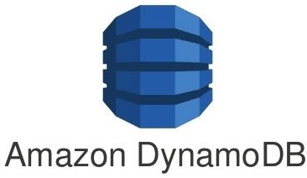
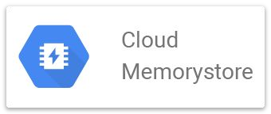
NoSQL Databases Caching and Feature Lookup
In memory cache, Sub milliseconds read latency
Single digit milliseconds read latency, in memory cache available
Scaleable, handles dynamically changing data, Milliseconds read latency
Scaleable, can handle slowly changing data, Milliseconds read latency
These resources are expensive
Carefully choose caching requirements based on your needs.

Slide 87
Data Preprocessing
Model Serving: Patterns and Infrastructure

Slide 88
Data Preprocessing and Inference
Observation
REST API
Model
Prediction

Slide 89
Data Preprocessing and Inference
Observation
REST API
Model
Prediction

Slide 90
Data Preprocessing and Inference
Observation
REST API
Model
Prediction

Slide 91
Preprocessing Operations Needed Before Inference
Data Cleansing
Feature Tuning
Feature Construction
Normalization
Clipping outliers
Imputing Missing Values
Combine inputs
Feature crossing
Polynomial expansion
Correcting invalid values in incoming data
Representation Transformation
Feature Selection
Change data format for the model
One-hot encoding
Vectorization
Apply same feature selection done during training on incoming data and features fetched from cache

Slide 92
Preprocessing Operations Needed Before Inference
Data Cleansing
Feature Tuning
Feature Construction
Normalization
Clipping outliers
Imputing Missing Values
Combine inputs
Feature crossing
Polynomial expansion
Correcting invalid values in incoming data
Representation Transformation
Feature Selection
Change data format for the model
One-hot encoding
Vectorization
Apply same feature selection done during training on incoming data and features fetched from cache

Slide 93
Preprocessing Operations Needed Before Inference
Feature Tuning Feature Construction
Data Cleansing
Normalization
Clipping outliers
Imputing Missing Values
Combine inputs
Feature crossing
Polynomial expansion
Correcting invalid values in incoming data
Representation Transformation Feature Selection
Change data format for the model
One-hot encoding
Vectorization
Apply same feature selection done during training on incoming data and features fetched from cache

Slide 94
Preprocessing Operations Needed Before Inference
Data Cleansing
Feature Tuning Feature Construction
Normalization
Clipping outliers
Imputing Missing Values
Combine inputs
Feature crossing
Polynomial expansion
Correcting invalid values in incoming data
Representation Transformation
Feature Selection
Change data format for the model
One-hot encoding
Vectorization
Apply same feature selection done during training on incoming data and features fetched from cache

Slide 95
Preprocessing Operations Needed Before Inference
Data Cleansing
Feature Tuning
Feature Construction
Normalization
Clipping outliers
Imputing Missing Values
Combine inputs
Feature crossing
Polynomial expansion
Correcting invalid values in incoming data
Representation Transformation
Feature Selection
Change data format for the model
One-hot encoding
Vectorization
Apply same feature selection done during training on incoming data and features fetched from cache

Slide 96
Preprocessing Operations Needed Before Inference
Data Cleansing
Feature Tuning
Feature Construction
Normalization
Clipping outliers
Imputing Missing Values
Combine inputs
Feature crossing
Polynomial expansion
Correcting invalid values in incoming data
Feature Selection
Representation Transformation
Change data format for the model
One-hot encoding
Vectorization
Apply same feature selection done during training on incoming data and features fetched from cache

Slide 97
Processing After Obtaining Predictions
Observation
REST API
Model
Prediction

Slide 98
Processing After Obtaining Predictions
Observation
REST API
Model
Prediction

Slide 99
Batch Inference
Model Serving: Patterns and Infrastructure

Slide 100

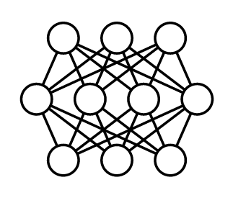




Batch Inference
...
X
X
X
X
Generating predictions on batch of a observations
1
2
3
N
Batch jobs are often generated on some recurring schedule
...
y₁
y₂
y₃
y_{N}
Predictions are stored and made available to developers or end users

Slide 101
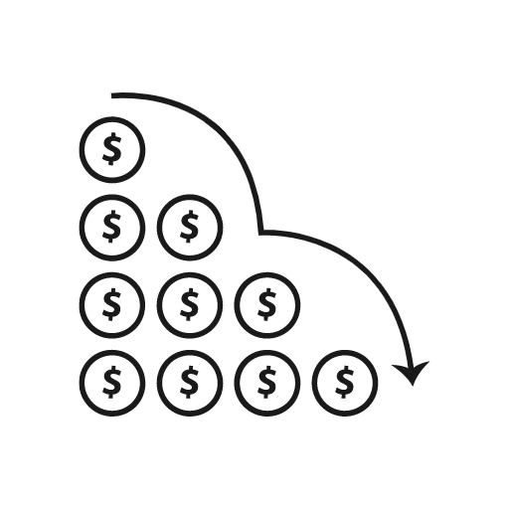



Advantages of Batch Inference
Reduced cost of ML system
X
Caching not required
Complex machine learning models for improved accuracy
Longer data retrieval
Not a problem as predictions are not in real time

Slide 102

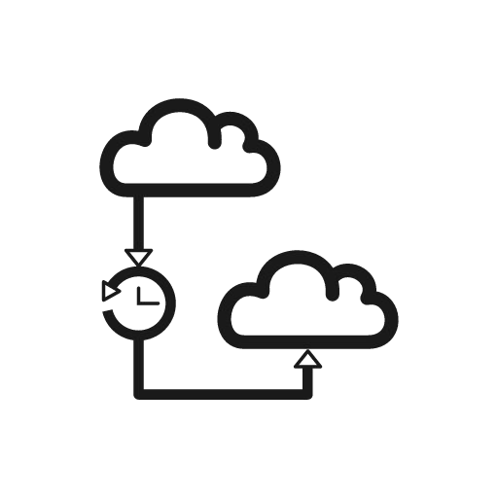


Limitations of Batch Inference
Recommendations from same age bracket
Recommendations from same geolocation
Long Update Latency
Predictions based on older data

Slide 103
Limitations of Batch Inference
Important Metrics to Optimize
Most important metric to optimize while performing batch predictions:
Throughput
Prediction service should be able to handle large volumes of inferences at a time.
Predictions need not be available immediately.
Latency can be compromised.

Slide 104
Limitations of Batch Inference
How to Increase Throughput?
Use hardware accelerators like GPU’s, TPU’s.
Increase number of servers/workers
Load several instances of model on multiple workers to increase throughput

Slide 105




Use Case - Product Recommendations
E-commerce sites: new recommendations on a recurring schedule
Cache these for easy retrieval
Enables use of more predictors to train more complex models.
Helps personalization to a greater degree, but with delayed data
Purchased by user
Similar Items
Recommend

Slide 106



Use Case - Sentiment Analysis
User sentiment based on customer reviews
No need for realtime prediction for this problem
CNN, RNN, or LSTM all work for this problem
These models are more complex, but more accurate for the problem
More cost effective to use them with batch prediction
My experience so far has been
The product is ok
Your support team
I guess
fantastic
is pathetic
POSITIVE
NEUTRAL
NEGATIVE

Slide 107



Use Case - Demand Forecasting
Estimate the demand for products for inventory and ordering optimization
Predict future based on historical data (time series)
Many models available as this is a batch predictions problem

Slide 108
Batch Inference
Using ML Models with Distributed Batch and Stream Processing Systems

Slide 109
Data Processing - Batch and Streaming
Data can be of different types based on the source.
Batch Data
Batch processing can be done on data available in huge volumes in data lakes, from csv ﬁles, log ﬁles etc.,
Streaming Data
Real-time streaming data, like data from sensors.

Slide 110
ETL on Data
Before data is used for making batch predictions:
It has to be extracted from multiple sources like log files, streaming sources, APIs, apps etc.,
Transformed
Loaded into a database for prediction
This is done using ETL Pipelines

Slide 111
ETL Pipelines
Transformation Engine
Batch Prediction Job on Prepared Data
Data Sources
Extract
Transform
Load
Target
Set of processes for
extracting data from data sources
Transforming data
Loading into an output destination like data warehouse
From there data can be consumed for training or making predictions using ML models,

Slide 112
Distributed Processing
Worker
Load
Cluster Manager
Worker
Extract
Data Sources
Worker
Target
ETL can be performed huge volumes of data in distributed manner.
Data is split into chunks and parallely processed by multiple workers.
The results of the ETL workﬂow are stored in a database.
Results in lower latency and higher throughput of data processing.

Slide 113



ETL Pipeline components Batch Processing
Transformation Engine
Batch Prediction Job on Prepared Data
Data Sources
Transform
Load
Target
Data Warehouse Eg: BigQuery
Data Mart
Data Lake
Eg: Cloud Storage
CSV Files
XML
JSON
APIs
Data Lake (like cloud storage)
+
Cloud DataFlow

Slide 114


ETL Pipeline Components Stream Processing
Transformation Engine
Consumed for ML pipeline training/ prediction
Streaming Data Sources
Transform
Load
Target
Streaming data for another pipeline
Data Warehouse Eg: BigQuery
Data Mart
Data Lake
Eg: Cloud Storage
+
Pub Sub
Cloud DataFlow
Streaming

